Slide 1

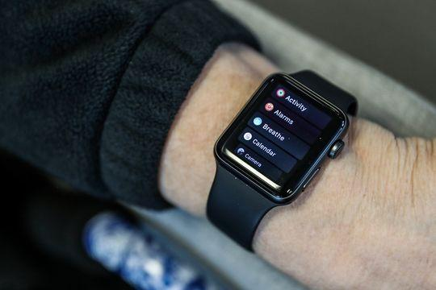
SHOP ONLINE TRIAL ONLINE
PRESENTED BY :
-Ajith Akuthota

Slide 2



: To build augmented reality
shopping experience
: To decrease online returns and
trial online products at home
: To elevate shopping experience
from buying to trialing

Slide 3
INTRODUCTION:
When it comes to online and offline shopping, most of the people end up with offline shopping as they go taking trials of the accessories to feel it on their body. While in online shopping, we select a product and it can be trailed only after delivery, most of us end up with a reason that the product doesn’t suits me. This has been a major reason for most of the online returns now a days. How about having a virtual experience of our desired product on our body? Run up with these thoughts, we have come up with an idea of creating an augmented reality of product while we buy online and have an experience on our body which is similar to trailing it offline.

Slide 4
REQUIREMENTS:
Laptop / Desktop PC
ROM Space: 2.5GB (Min.) – 10GB (Max)
RAM Space: 4GB (Min.) – 8GB (Max)
OS: Windows 10/8/7 – 64 Bit/32 Bit [Preferred: 64 Bit]
USB Keyboard, USB Mouse with Scroll Wheel
Processor: i3 (Min) – i7 (Max)
Java JDK (Pre-Installed)
SDK (Pre-Installed)

Slide 5


PROCESS:
To work with augmented reality there are many more software but we are working with unity editor
For this we need to have the unity account and vuforia developer account
https://developer.vuforia.com/vui/auth/register this is the link for registration of vuforia account

Slide 6
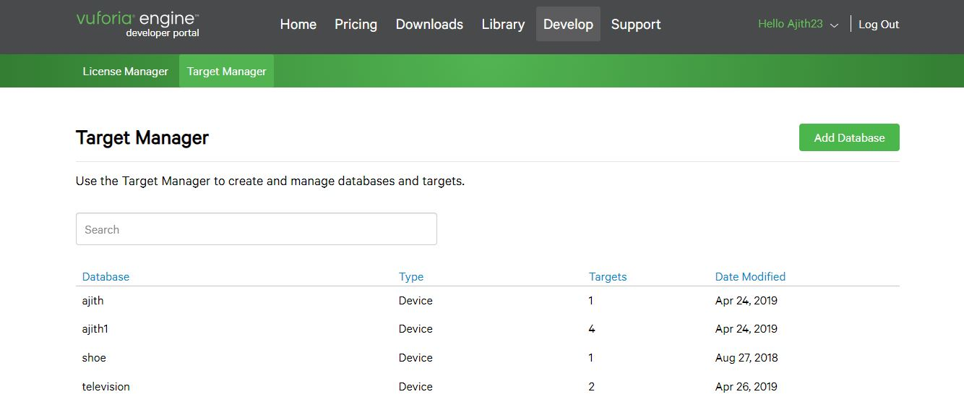
VUFORIA DEVELOPER PORTAL:

Slide 7
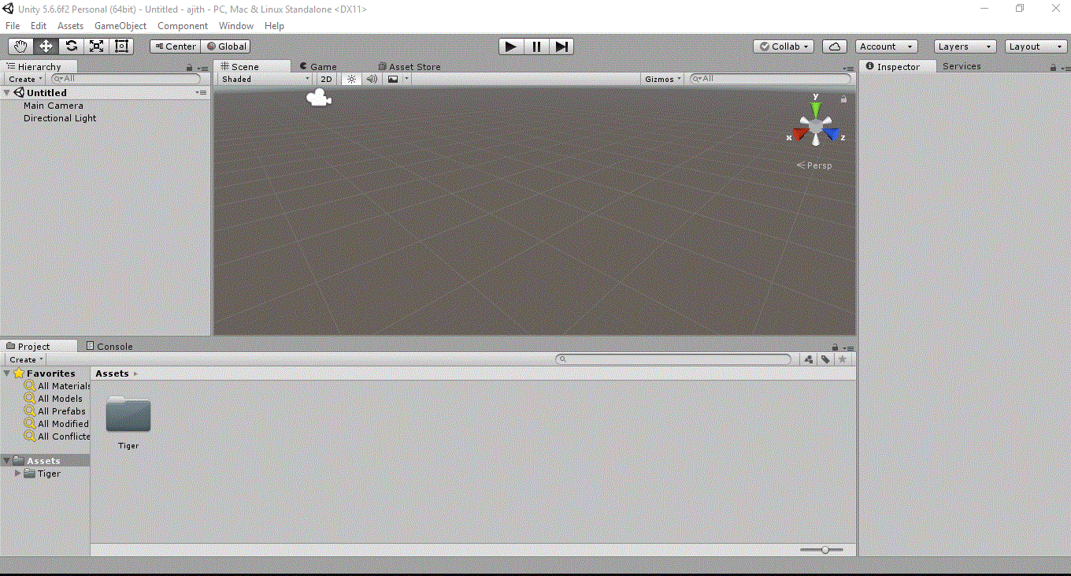
Unity editor:

Slide 8
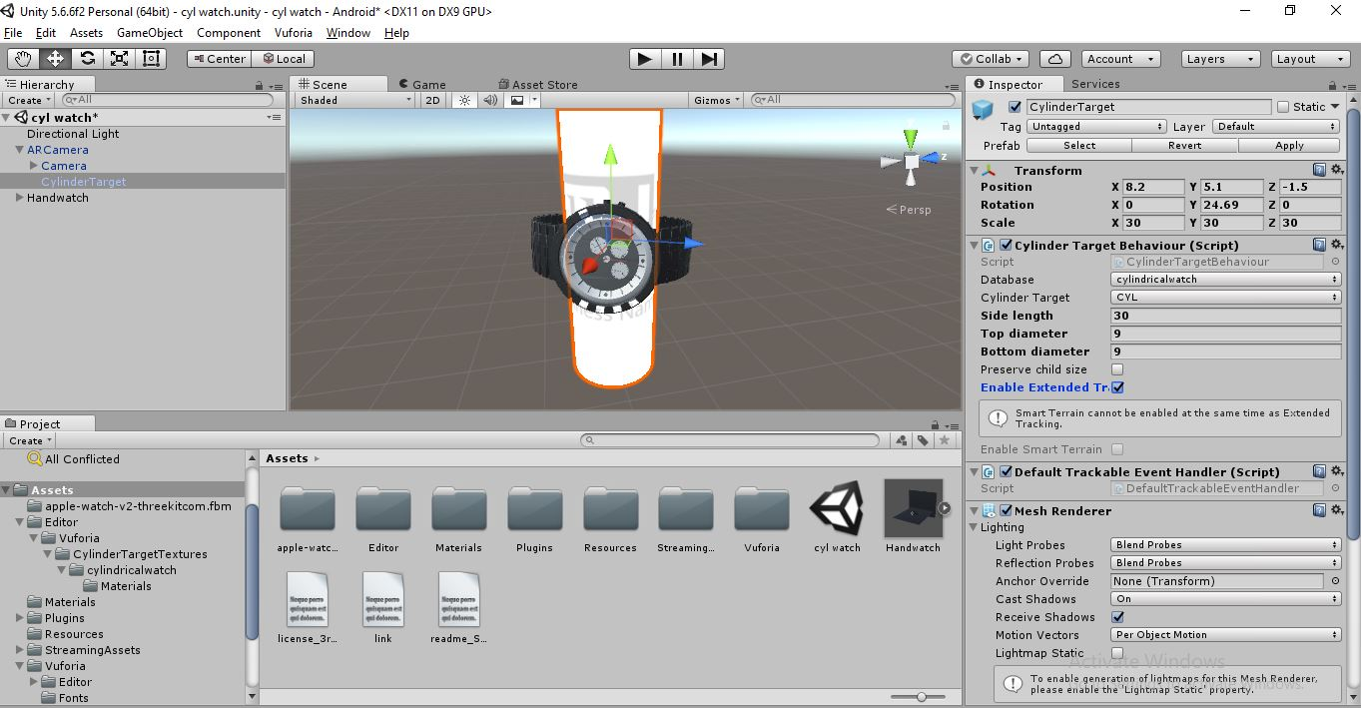
PROJECT MAKING:

Slide 9
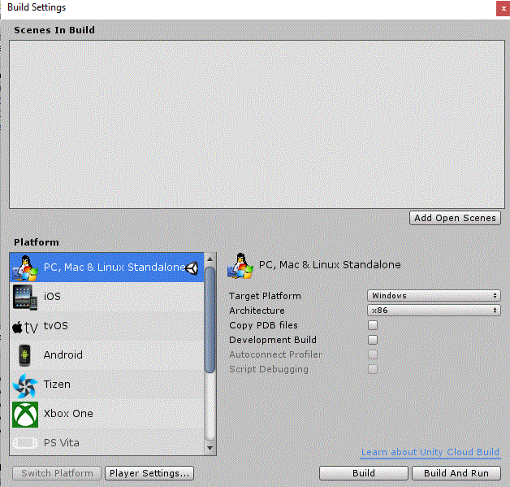
Complete the changes for building and conversion of editor into an app by using jdk file

Slide 10

ADVANTAGES:
-> Equips us with a virtual shopping experience
-> Reduces online returns
-> Saves time and energy
DISADVANTAGES:
-> Vuforia and unity are based on image tracking,without any image target we can’t virtually project things

Slide 11
CONCLUSION:
By extending the idea of augmented reality in the era of shopping we can have an excellent shopping experience!!

Slide 12


ANY DOUBTS??

